Slide 1
Technology Education Key Learning Area Information and Communication Technology Knowledge Context (Junior Secondary)
Modules: K2 Programming Concepts and
K16 Information Processing and Presentation
Objective: To enhance students’ understanding of epidemic prevention through designing a program
Notes:
探討資訊科技的應用和其影響

Slide 2
Suggested activities and related learning content
To design an anti-epidemic program using Scratch
Objectives:
To learn about COVID-19
To understand the correct ways to fight the virus
To cultivate students' information literacy (including nurturing positive values and attitudes)
2. Learning content:
K2 Programming Concepts (Problem solving procedures and techniques, Data manipulation)
K16 Information processing and Presentation (Computer and computer operation, Multimedia elements and production)

Slide 3
Activity 1: Collect information (1)
During the epidemic, proper and correct use of Information Technology can reduce the impact of epidemic on our daily lives and society as well as avoid people's face-to-face contact effectively.
Try to find out what measures can be used to reduce the risk of spreading virus effectively during the epidemic.

Slide 4
Activity 1: Collect information (2)
Distribute learning materials through web pages and electronic platform for online learning
Establish a home office using computer network
Learn about information on anti-epidemic supplies through reliable channels such as official website of the government or related organisations

Slide 5
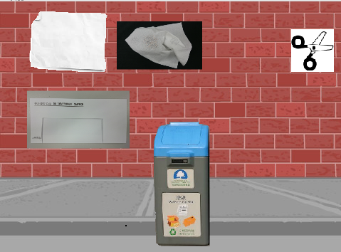
Activity 2: Write a program (1)
Design an anti-epidemic program to enhance students’ understanding of the correct ways to fight against the virus and prevent its spreading in the community.
Reference resources: Simulation package for clean recycling (Chinese version only)
Hyperlink: https://www.edb.gov.hk/attachment/tc/curriculum-development/4-key-tasks/it-for-interactive-learning/modular-computer-awareness-programme/module8C2_tc.zip

Slide 6
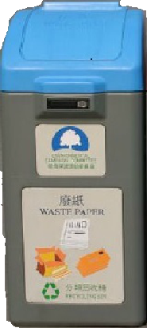
Activity 2: Write a program (2)
Read the "Simulation package for clean recycling" worksheet to understand its programming skills, and to design an anti-epidemic program by modifying the program codes and reusing sprites
Set up reusing sprites:
Recycle bin
COVID-19
COVID-19

Slide 7
Activity 2: Write a program (3)
Reuse/remix program codes:
Measures that can reduce the risk of spreading of virus
Recyclable materials
Distribute learning materials through web pages and electronic platform for online learning
Establish a home office using computer network
Learn about information on anti-epidemic supplies through reliable channels such as official website of the government or related organisations

Slide 8
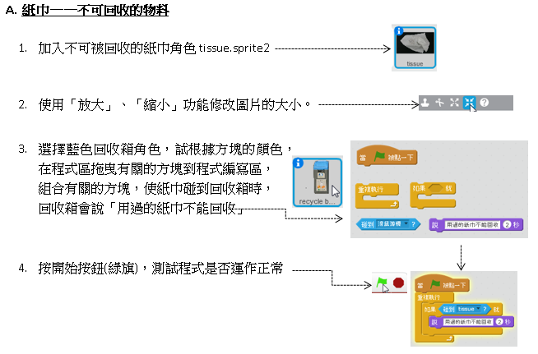
Activity 2: Write a program (4)
A. Tissue - Non-recyclable material
Insert tissue as a sprite that is non-recyclable: tissue.sprite2
Use “enlarge” and “reduce” function to modify the picture size
Any other sprites or program codes shown in the picture that can be modified?
Select the sprite for blue recycle bin. With reference to the block colours, drag and drop the relevant blocks to the code area and combine the blocks. The recycle bin will show “Used tissues cannot be recycled” when the tissue touches the recycle bin
Press start button (the green flag) to test if the program functions properly.
Try to find out other program codes that can be reused or remixed. Use creativity to complete your own program.

Slide 9
Reference Resources
Students may find lots of information about the epidemic from the Internet. However, it is important to know how to distinguish the authenticity of information. For details, please refer to the following web pages:
(1) Educational Television
網絡資訊真定假 (Chinese version only)
https://www.hkedcity.net/etv/en/resource/4373387131
(2) 網絡偽術 (Chinese version only)
https://www.hkedcity.net/hq/en/teen
(3) Related Support on Information Literacy and e-Safety - Information Literacy for Hong Kong Students
https://www.edb.gov.hk/en/edu-system/primary-secondary/applicable-to- primary-secondary/it-in-edu/information-literacy/il-index.html

